Slide 1
Challenges to detection of early warning signals of regime shifts
Alan Hastings
Dept of Environmental Science and Policy
UC Davis
Acknowledge: US NSF
Collaborators: Carl Boettiger, Derin Wysham, Julie Blackwood, Pete Mumby

Slide 2
Outline
An example that indicates what can be done, and why we might want to do it: The coral example
Present mathematical arguments for transients, and what it implies about regime shifts
A statistical approach to early warning signs for the saddle-node

Slide 3
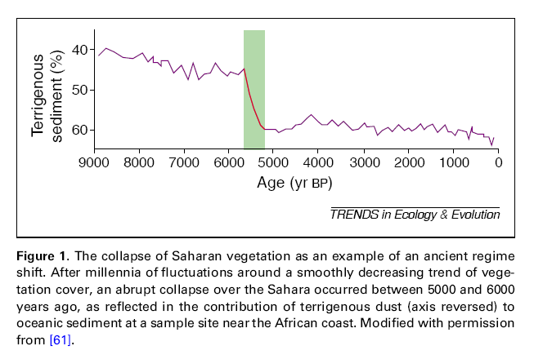
Ecosystems can exhibit ‘sudden’ shifts
Scheffer and Carpenter, TREE 2003, based on deMenocal et al. 2000 Quat Science Reviews

Slide 4
Outline
An example that indicates what can be done, and why we might want to do it: The coral example
Present mathematical arguments for transients, and what it implies about regime shifts
A statistical approach to early warning signs for the saddle-node

Slide 5
An example: coral reefs and grazing
Demonstrate the role of hysteresis in coral reefs by extending an analytic model (Mumby et al. 2007*) to explicitly account for parrotfish dynamics (including mortality due to fishing)
Identify when and how phase shifts to degraded macroalgal states can be prevented or reversed
  Provide guidance to management decisions regarding fishing regulations
  Provide ways to assign value to parrotfish

Slide 6
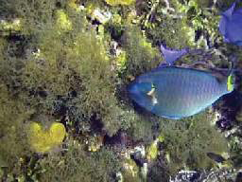
Parrotfish graze and keep macroalgae from overgrowing the coral

Slide 7
Use a spatially implicit model with three states – then add fish
M, macroalgae (overgrows coral)
T, turf algae
C, Coral
M+T+C=1
Easy to write down three equations describing dynamics
So need equations only for M and C
Can solve this model for equilibrium and for dynamics (Mumby, Edwards and Hastings, Nature)

Slide 8
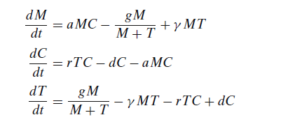
Yes, equations are easy to write, drop last equation, explain

Slide 9
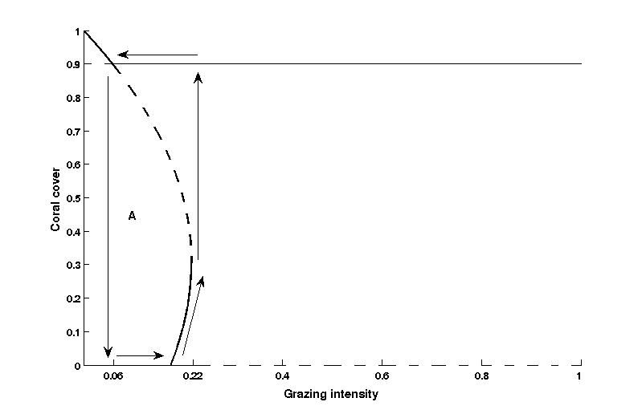
Hysteresis through changes in grazing intensity
Bifurcation diagram of grazing intensity versus coral cover using the original model
Solid lines are stable equilibria, dashed lines are unstable
Arrows denote the hysteresis loop resulting from changes in grazing intensity
The region labeled “A” is the set of all points that will end in macroalgal dominance without proper management

Slide 10
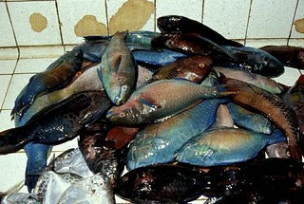
But parrotfish are subject to fishing pressure, so need to include the effects of fishing and parrotfish dynamics, and only control is changing fishing

Slide 11
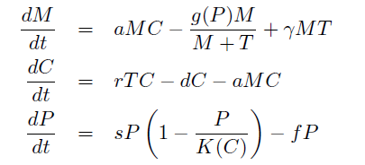
Simple analytic model
Overgrowth
Overgrowth
Blackwood, Hastings, Mumby, Ecol Appl 2011; Theor Ecol 2012

Slide 12
Simple analytic model
Grazing

Slide 13
Simple analytic model
Overgrowth

Slide 14
Simple analytic model
Grazing
Dependence of parrotfish dynamics on coral

Slide 15
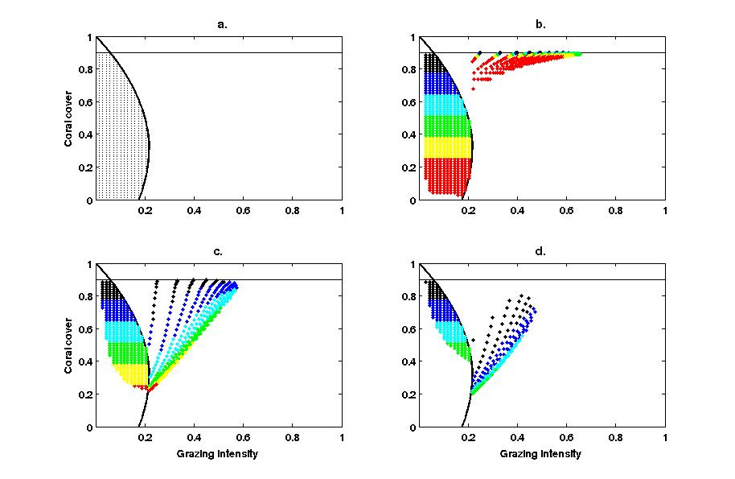
Coral recovery via the elimination of fishing effort – depends critically on current conditions
Coral
Initial
conditions
With extended model, simulations of points in region “A” (Figure a.) assuming there is no fishing effort
Figures b.-d. are the results for different initial conditions. Points in the region “A” are points that can be controlled to a coral-dominated state and the points outside of the region are the ending location after 5 years with no fishing mortality
(Blackwood, Mumby and Hastings, Theoretical Ecology,2012)

Slide 16
Coral recovery via the elimination of fishing effort – depends critically on current conditions
Coral
Initial
conditions
No macroalgae
With extended model, simulations of points in region “A” (Figure a.) assuming there is no fishing effort
Figures b.-d. are the results for different initial conditions. Points in the region “A” are points that can be controlled to a coral-dominated state and the points outside of the region are the ending location after 5 years with no fishing mortality

Slide 17
Coral recovery via the elimination of fishing effort – depends critically on current conditions
Coral
Initial
conditions
No macroalgae
Macroalgae
at long term equilibrium
With extended model, simulations of points in region “A” (Figure a.) assuming there is no fishing effort
Figures b.-d. are the results for different initial conditions. Points in the region “A” are points that can be controlled to a coral-dominated state and the points outside of the region are the ending location after 5 years with no fishing mortality

Slide 18
Coral recovery via the elimination of fishing effort – depends critically on current conditions
Coral
Initial
conditions
No macroalgae
Macroalgae
at long term equilibrium
No turf
With extended model, simulations of points in region “A” (Figure a.) assuming there is no fishing effort
Figures b.-d. are the results for different initial conditions. Points in the region “A” are points that can be controlled to a coral-dominated state and the points outside of the region are the ending location after 5 years with no fishing mortality

Slide 19
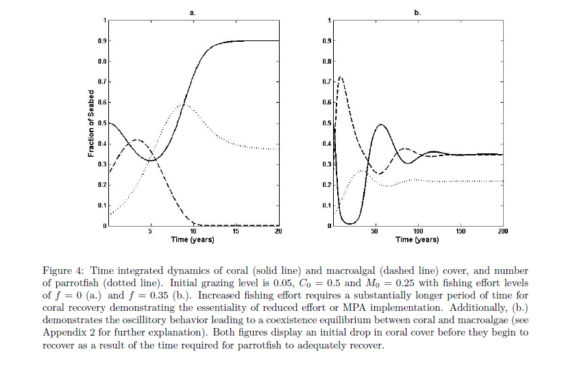
Recovery time scale depends on fishing effort level and is not monotonic
coral
coral

Slide 20
Recovery time scale depends on fishing effort level and is not monotonic
coral
coral

Slide 21
Recovery time scale depends on fishing effort level and is not monotonic
coral
coral

Slide 22
Outline
An example that indicates what can be done, and why we might want to do it: The coral example
Present mathematical arguments for transients, and what it implies about regime shifts
A statistical approach to early warning signs for the saddle-node

Slide 23
Moving beyond the saddle-node
What possibilities are there for thresholds?
First, more background

Slide 24
Discrete time density dependent model: x(t+1) vs x(t) (normalized)
Next year
This year

Slide 25
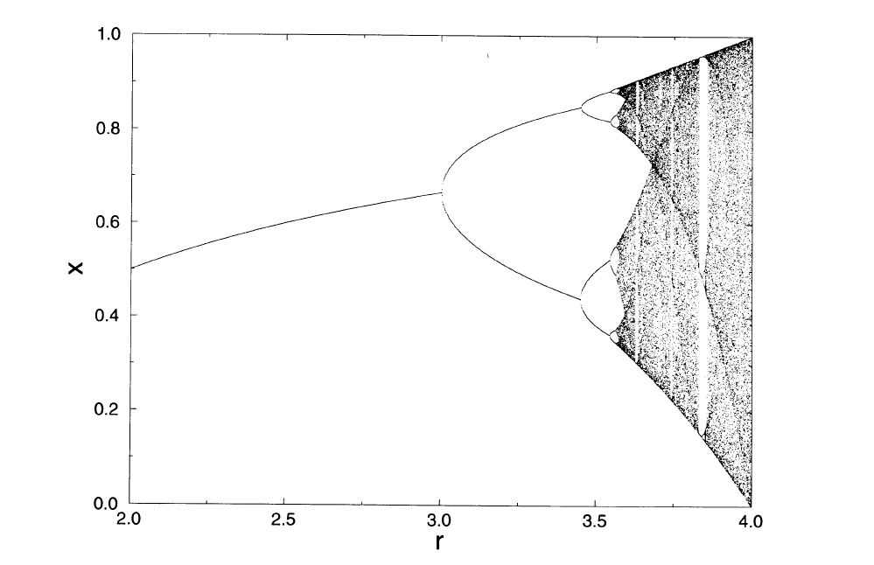
Certain characteristics of simple models are generic, and indicate chaos

Slide 26
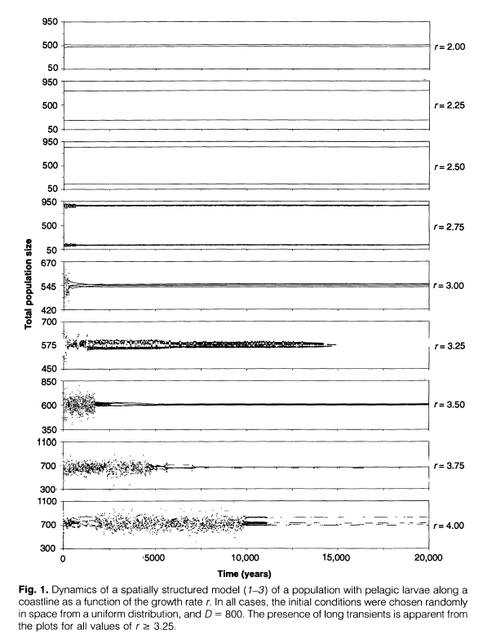
Alternate growth and dispersal and look at dynamics
Use the kind of overcompensatory growth
Location before dispersal
Distribution of locations
after dispersal in space
Hastings and Higgins, 1994

Slide 27


Two patches, single species
Hastings, 1993, Gyllenberg et al 1993
Alternate growth

Slide 28

Two patches, single species
Hastings, 1993, Gyllenberg et al 1993
Alternate growth
And then dispersal

Slide 29
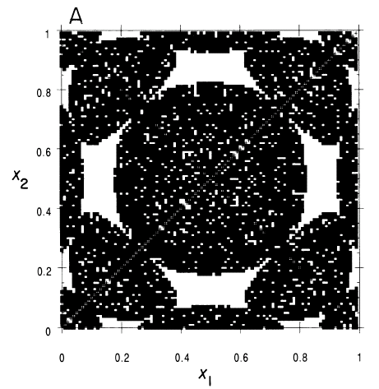
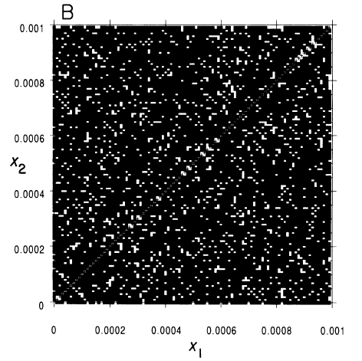
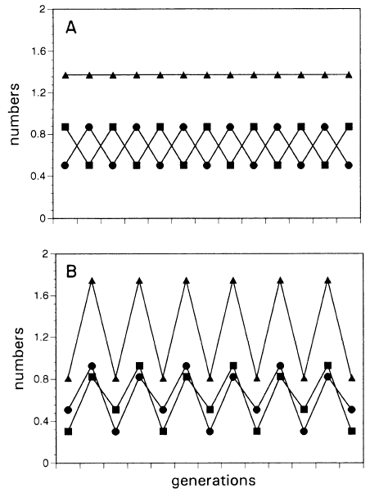
Black ends up as B, white ends up as A

Slide 30
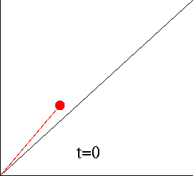
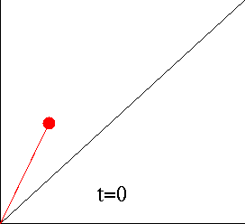
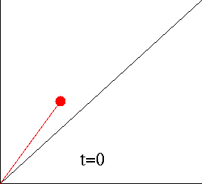
Three different initial conditions
Patch 2
Patch 1

Slide 31
Analytic treatment of transients in coupled patches (Wysham & Hastings, BMB, 2008; H and W, Ecol Letters 2010; in prep) helps to determine when, and how common
Depends on understanding of crises
  Occurs when an attractor ‘collides’ with another solution as a parameter is changed
  Typically produces transients
  Can look at how transient length scales with parameter values
Start with 2 patches and Ricker local dynamics

Slide 32
The concept of crises in dynamical systems (Grebogi et al., 1982, 1983) is an important (and under appreciated) aspect of dynamics in ecological models.
A crisis is defined to be a sudden, dramatic, and discontinous change in system behavior when a given parameter is varied only slightly.
There are various types of crises
Each class of crises has its own characteristic brand of transient dynamics, and there is a scaling law determining the average length of their associated transients as well (Grebogi et al., 1986, 1987).
So we simply need to find out how many and what type of crises occur (not so simple to do this)

Slide 33
Attractor merging crisis
In the range of parameters near an attractor merging crisis, we look at the unstable manifolds of period-2 orbits. These manifolds are invariant and represent the set of points that under backward iteration come arbitrarily close to the periodic point.
The transverse intersection of two such manifolds is known as a tangle and induces either complete chaos or chaotic transients (Robinson, 1995).

Slide 34
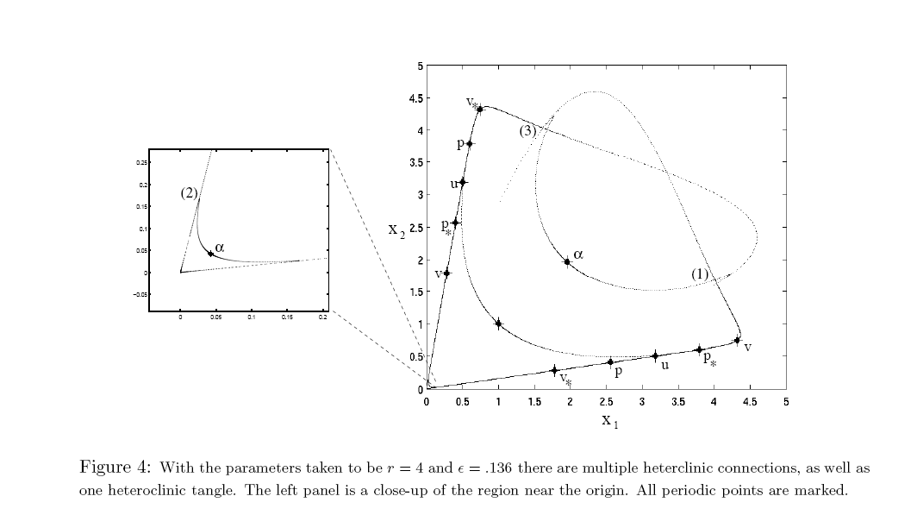
This figure essentially shows these kinds of transients are ‘generic’ in two patch coupled systems

Slide 35
Intermittent behavior
We then demonstrate the intermittent bursting characteristic of an attractor widening crisis
Two-dimensional bifurcation diagrams demonstrate that saddle-type periodic points collide with the boundary of an attractor, signifying the crisis.

Slide 36
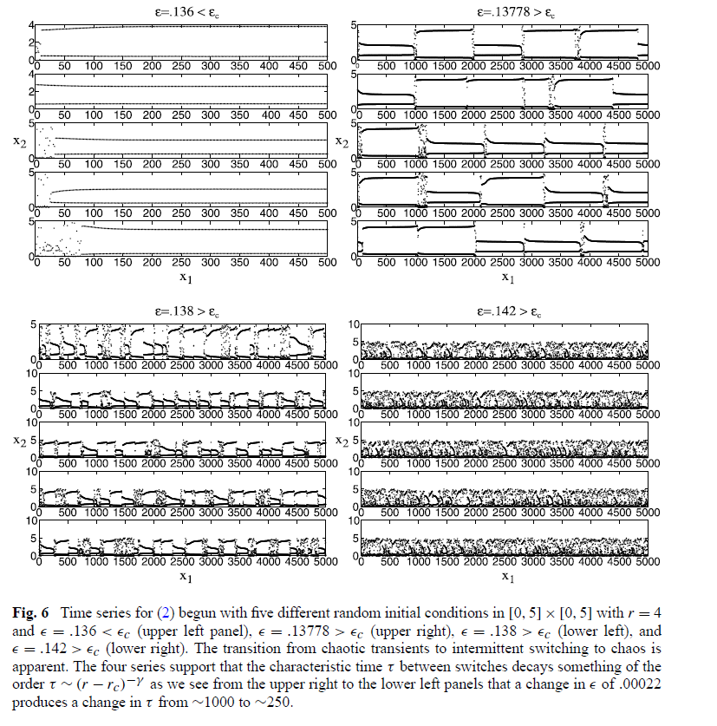

Slide 37
This argument about crises applies generally
Can show transients and crises occur in coupled Ricker systems by following back unstable manifolds
By extension we have a general explanation for sudden changes (regime shifts)
Very interesting questions about early warning signs of these sudden shifts
  The argument about crises says there are cases where we will not find simple warning signs because there are systems that do not have the kinds of potentials envisioned in the simplest models
  So part of the question about warning signs becomes empirical

Slide 38
Ricker model with movement in continuous space, described by a Gaussian dispersal kernel f (x, y).
Should exhibit regime shifts per our just stated argument
Should not expect to see early warning signs
Simulate to look for early warning signs of regime shifts
(Hastings & Wysham, Ecol Lett 2010)

Slide 39
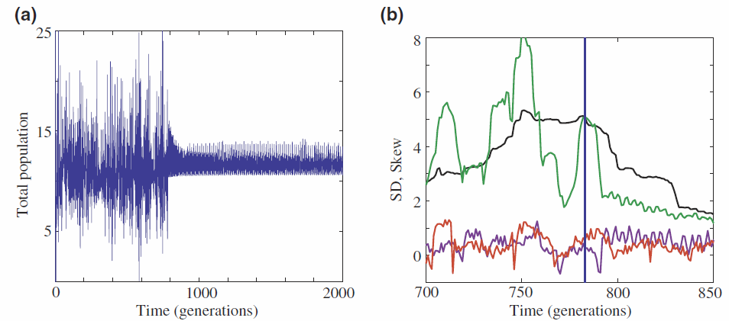
Simulations showing regime shifts in the total population for the integro-difference model. Shifts are marked with vertical blue lines. (a)A regime shift in the presence of small external perturbation (r = 0.01) occurs, and wildly oscillatory behaviour is replaced by nearly periodic motion. (b) The standard deviation (square root of the variance) plotted in black, green, and skew shown in red, purple for windows of widths 50 and 10, respectively.

Slide 40
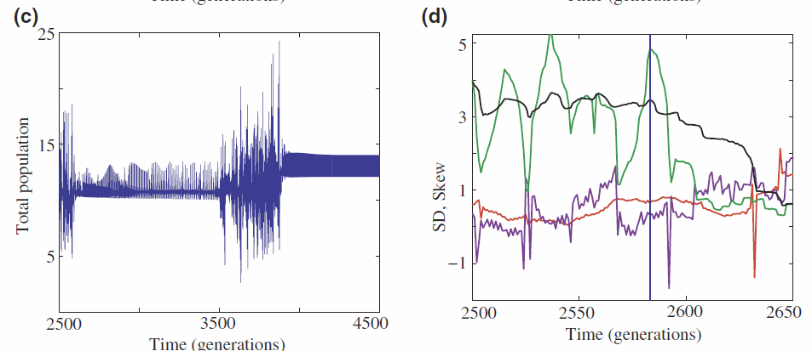
(c) Multiple regime shifts occur in the presence of large noise (r = 0.1), as the perturbation strength is strong enough to cause attractor switching. (d) The variance and skew shown in the same format as in (b), but around the first large shift in (c).

Slide 41
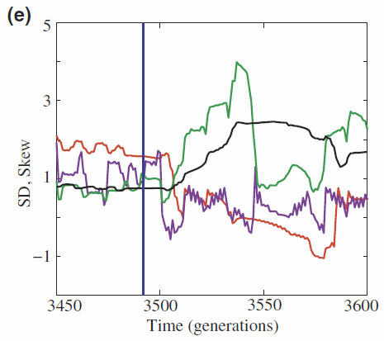
(c) Multiple regime shifts occur in the presence of large noise (r = 0.1), as the perturbation strength is strong enough to cause attractor switching. (e) The variance and skew around the second shift in (c).

Slide 42
OK, but what if the transition is a result of a saddle-node – can we see it coming?

Slide 43
Outline
An example that indicates what can be done, and why we might want to do it: The coral example
Present mathematical arguments for transients, and what it implies about regime shifts
A statistical approach to early warning signs for the saddle-node

Slide 44
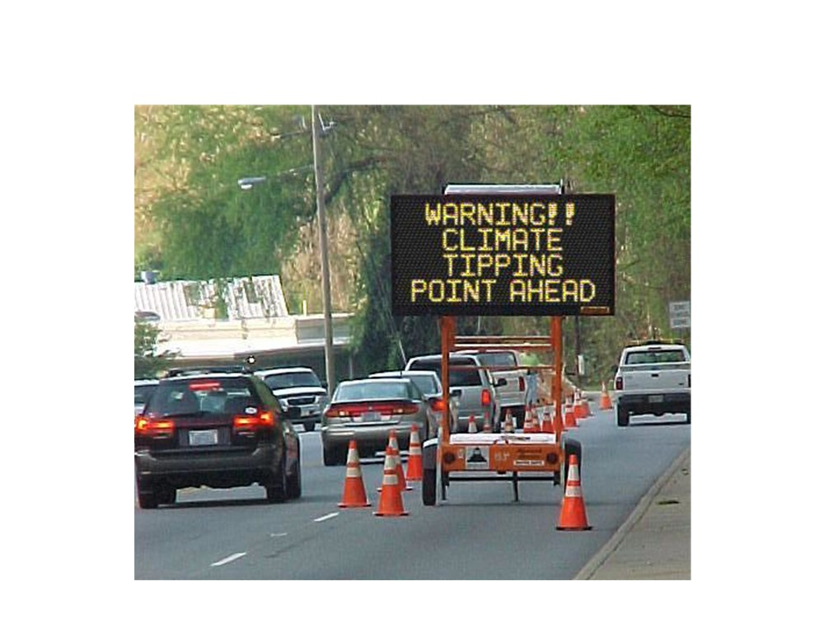
Tipping points: Sudden dramatic changes or regime
shifts. . .
Carl Boettiger & Alan Hastings, UC Davis cboettig@ucdavis.edu
Early Warning Signs

Slide 45
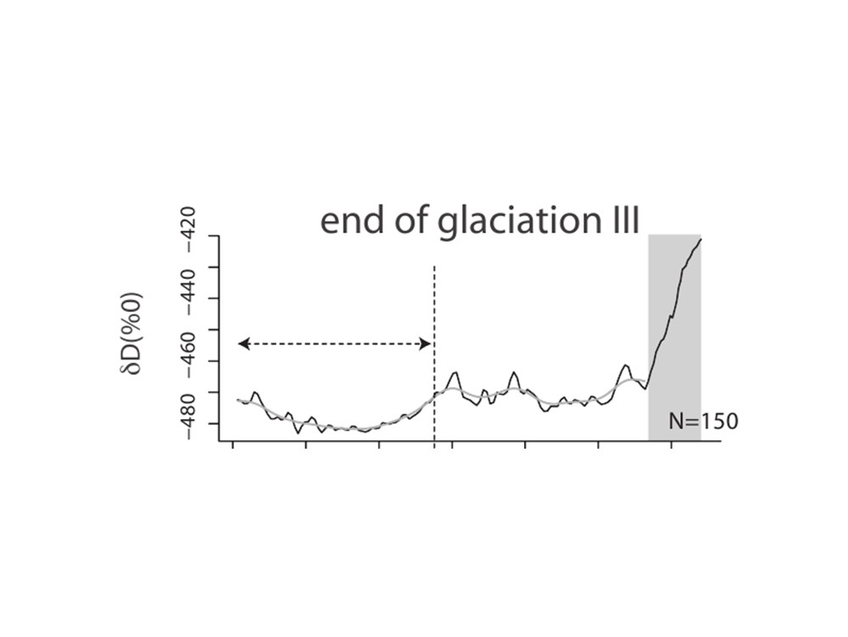
Some catastrophic transitions have already happened
Carl Boettiger & Alan Hastings, UC Davis cboettig@ucdavis.edu
Early Warning Signs

Slide 46
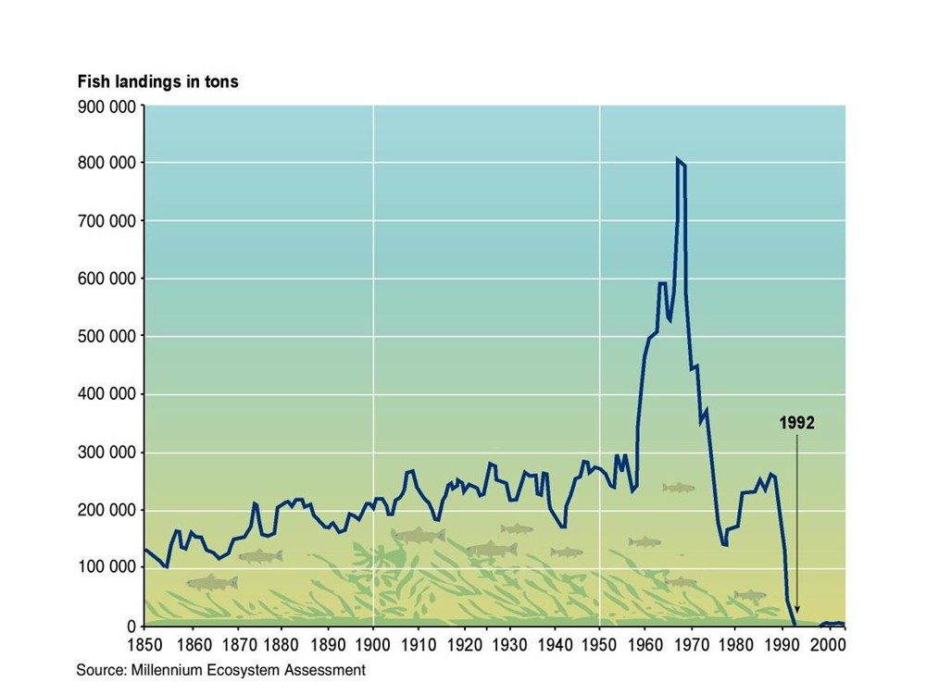
Some catastrophic transitions have already happened
Carl Boettiger & Alan Hastings, UC Davis cboettig@ucdavis.edu
Early Warning Signs

Slide 47
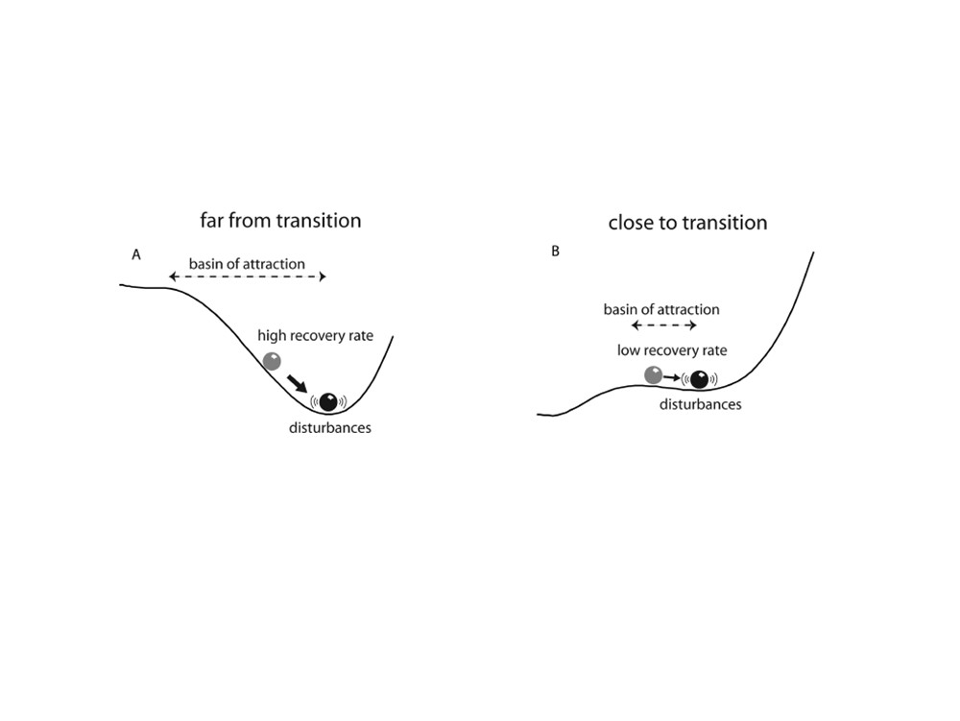
A simple theory built on the mechanism of bifurcations
Scheffer et al. 2009
Carl Boettiger & Alan Hastings, UC Davis cboettig@ucdavis.edu
Early Warning Signs
7/77

Slide 48
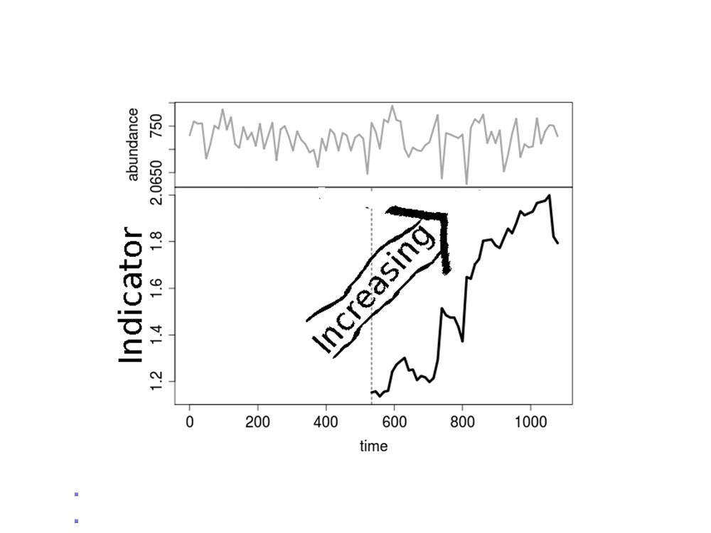
Early warning indicators
e.g. Variance: Carpenter & Brock 2006;
or Autocorrelation: Dakos et al. 2008; etc.
Carl Boettiger & Alan Hastings, UC Davis cboettig@ucdavis.edu
Early Warning Signs
8/77

Slide 49

Let’s give it a try. . .
Carl Boettiger & Alan Hastings, UC Davis cboettig@ucdavis.edu
Early Warning Signs
9/77

Slide 50
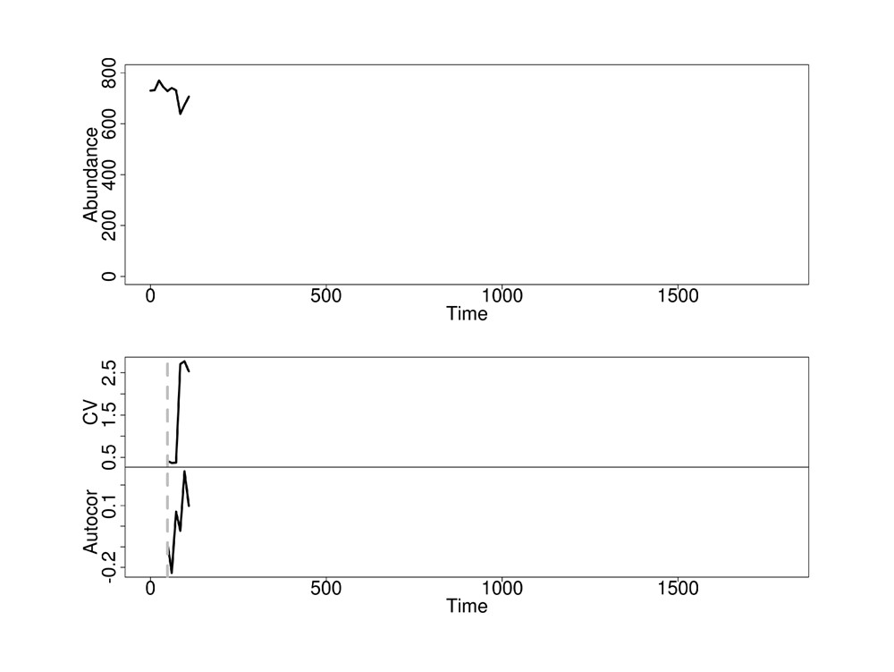
Carl Boettiger & Alan Hastings, UC Davis cboettig@ucdavis.edu
Early Warning Signs
10/77

Slide 51
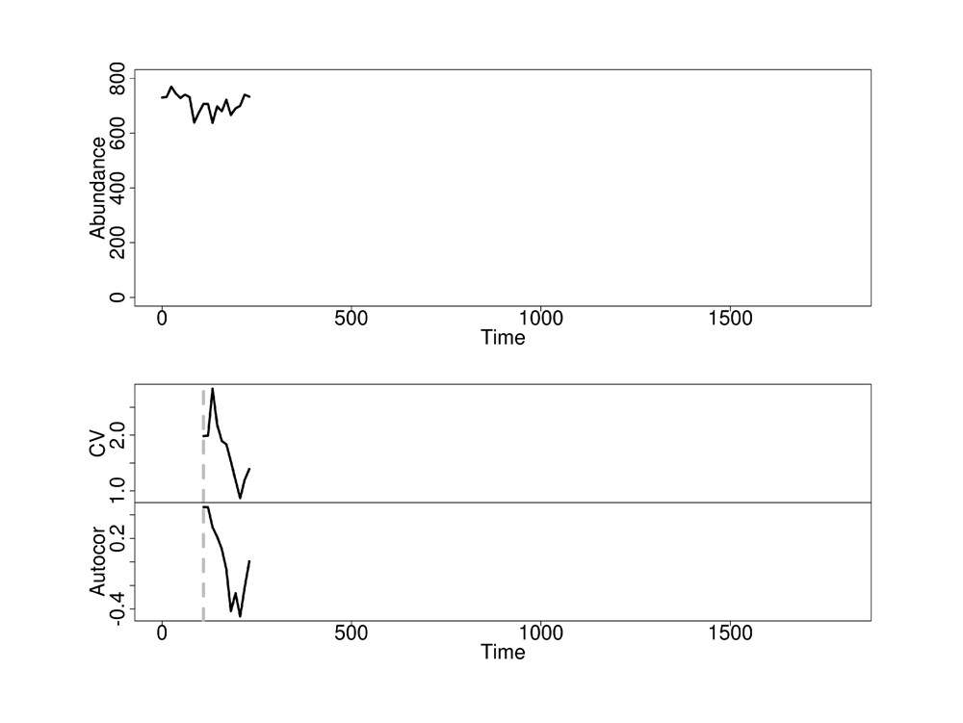
Carl Boettiger & Alan Hastings, UC Davis cboettig@ucdavis.edu
Early Warning Signs
11/77

Slide 52
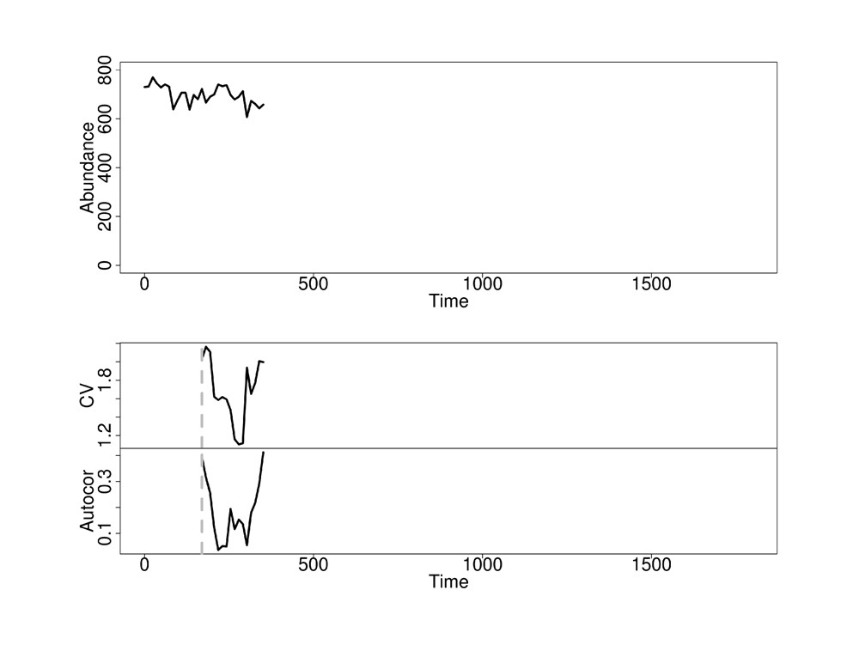
Carl Boettiger & Alan Hastings, UC Davis cboettig@ucdavis.edu
Early Warning Signs
12/77

Slide 53
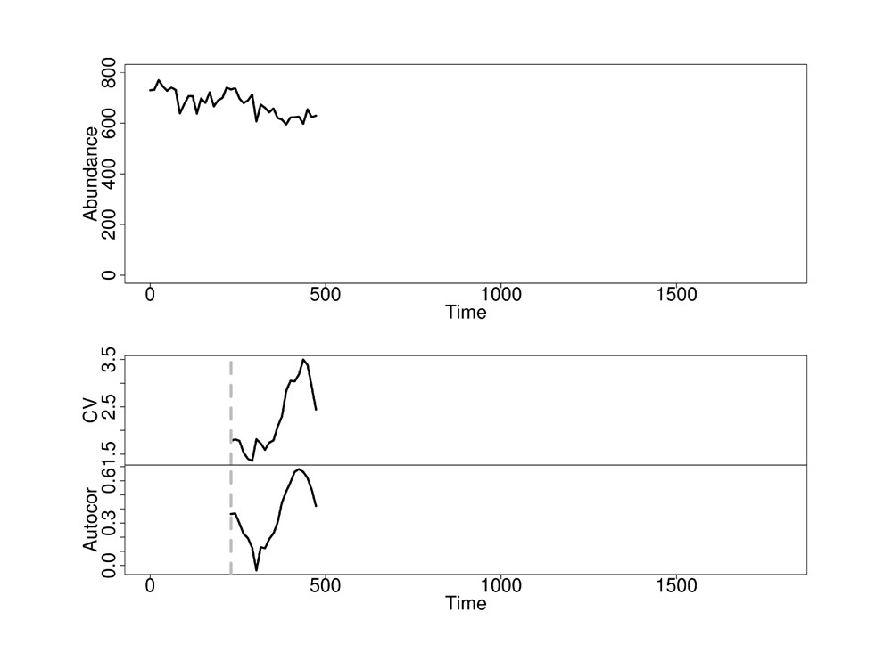
Carl Boettiger & Alan Hastings, UC Davis cboettig@ucdavis.edu
Early Warning Signs
13/77

Slide 54
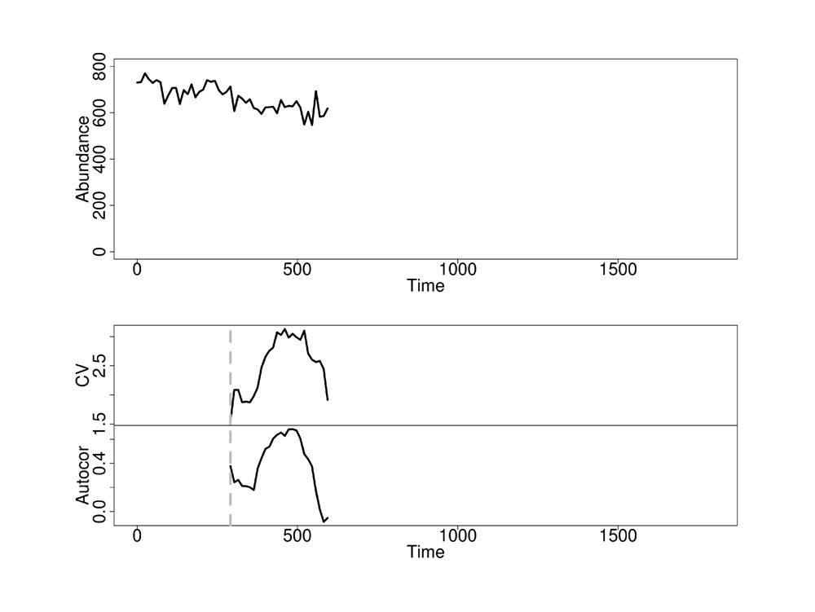
Carl Boettiger & Alan Hastings, UC Davis cboettig@ucdavis.edu
Early Warning Signs
14/77

Slide 55
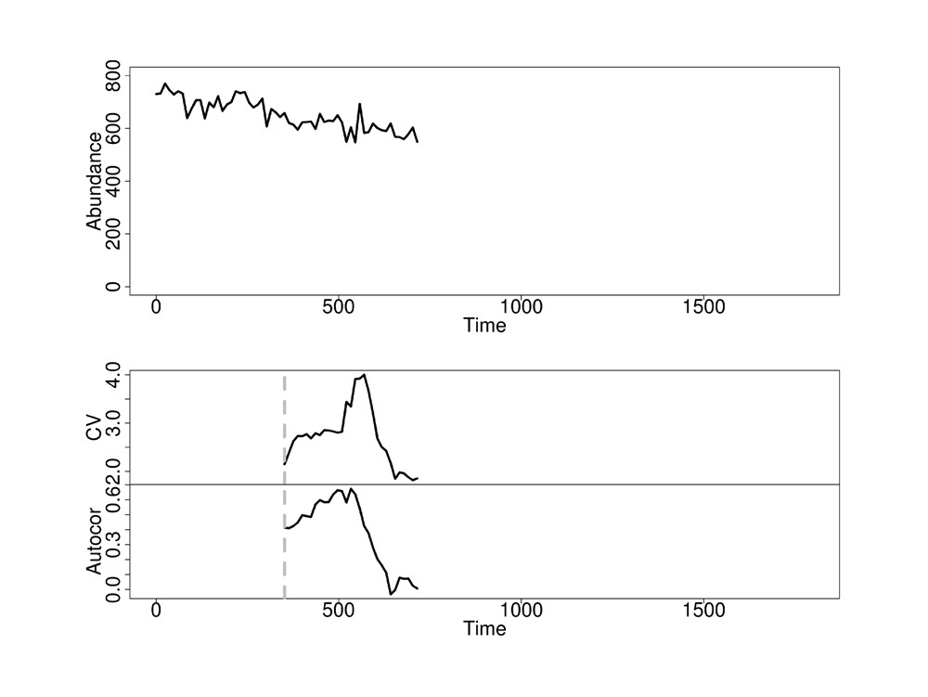
Carl Boettiger & Alan Hastings, UC Davis cboettig@ucdavis.edu
Early Warning Signs
15/77

Slide 56
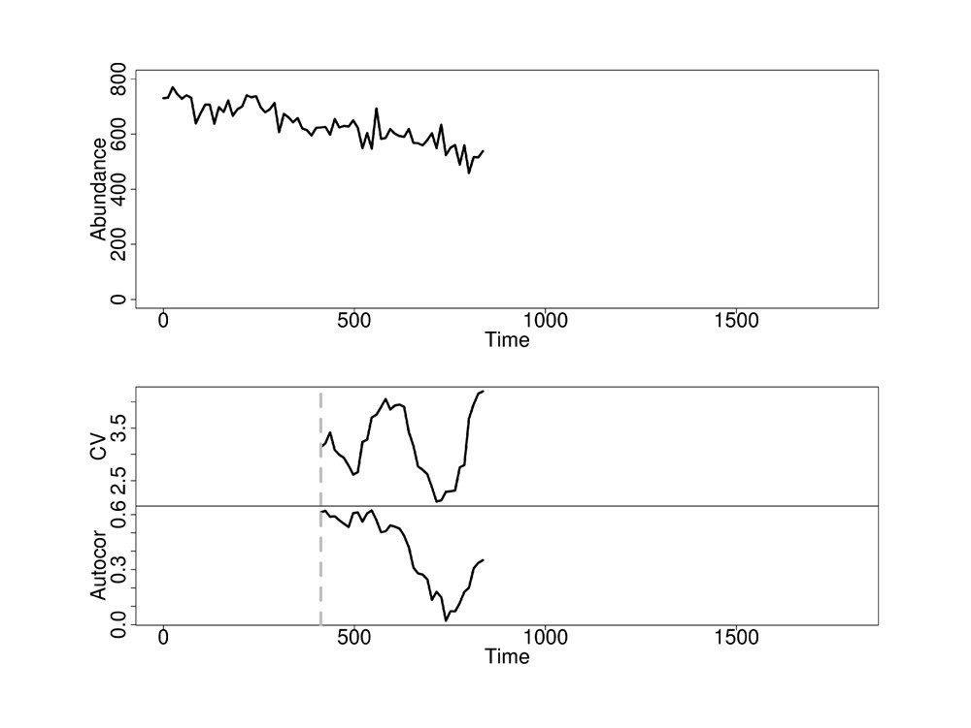
Carl Boettiger & Alan Hastings, UC Davis cboettig@ucdavis.edu
Early Warning Signs
16/77

Slide 57
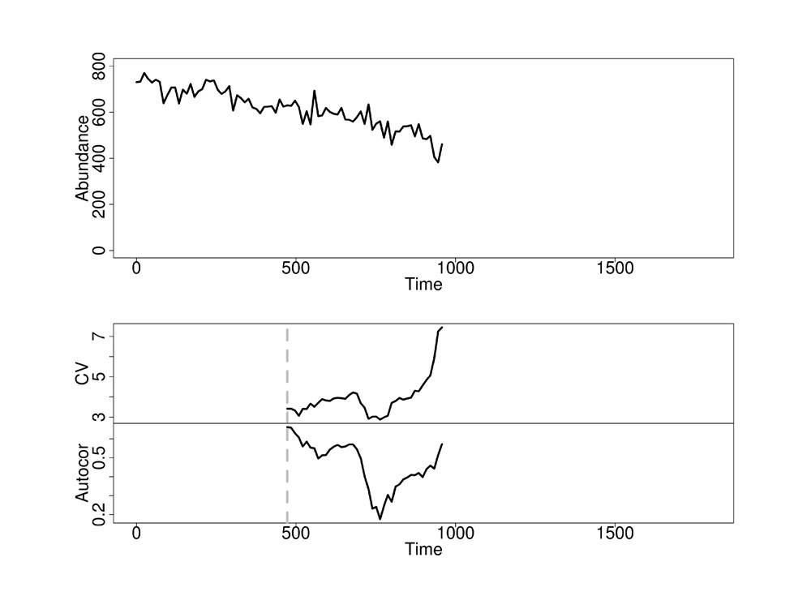
Carl Boettiger & Alan Hastings, UC Davis cboettig@ucdavis.edu
Early Warning Signs
17/77

Slide 58
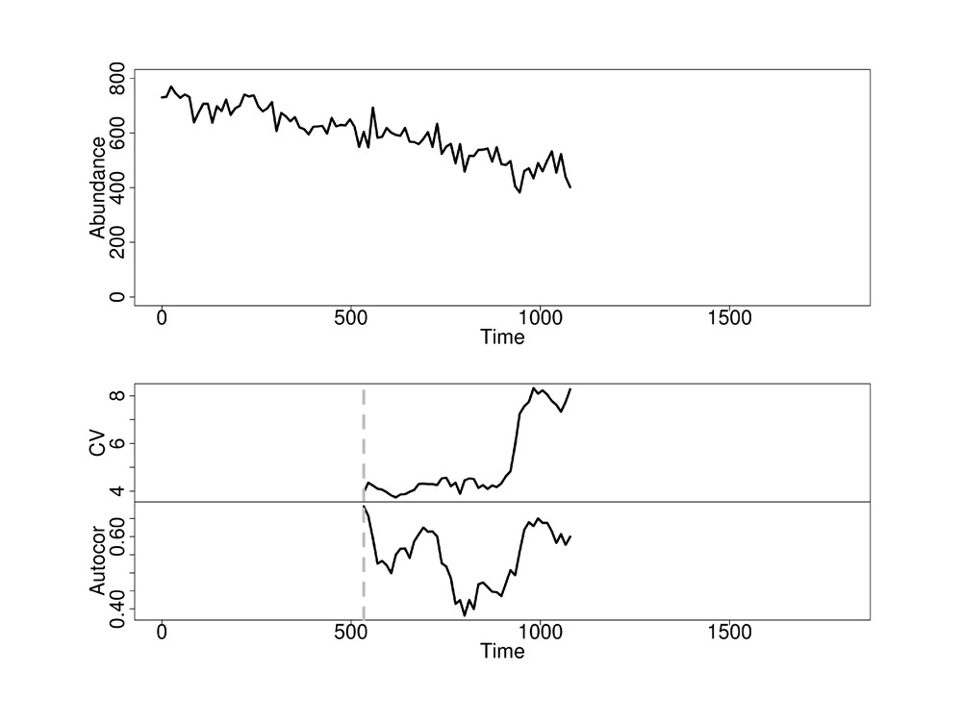
Carl Boettiger & Alan Hastings, UC Davis cboettig@ucdavis.edu
Early Warning Signs
18/77

Slide 59
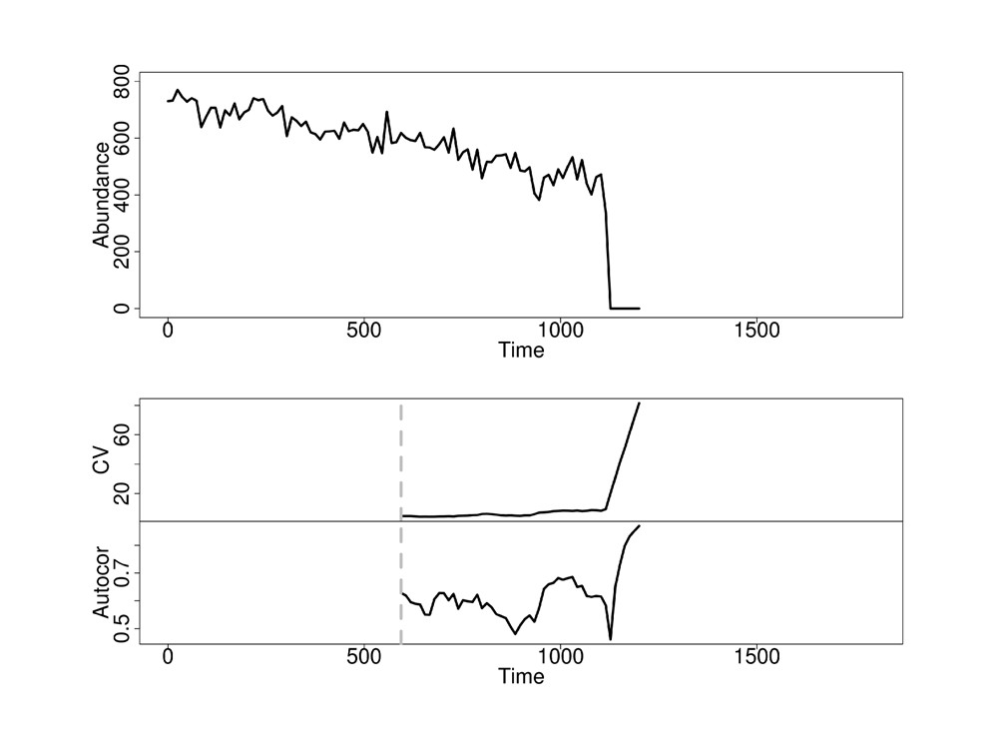
Carl Boettiger & Alan Hastings, UC Davis cboettig@ucdavis.edu
Early Warning Signs
19/77

Slide 60

Prediction Debrief. . .
So what’s an increase?
Do we have enough data to tell?
Which indicators to trust most?
Carl Boettiger & Alan Hastings, UC Davis cboettig@ucdavis.edu
Early Warning Signs
20/77

Slide 61
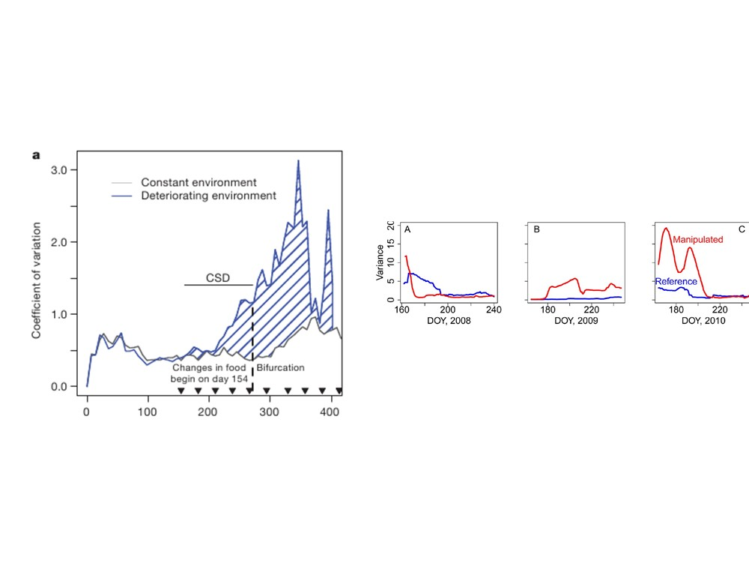
Empirical examples of early warning
Have relied on comparison to a control system:
Carpenter et al. 2011
Drake & Griffen 2010
Carl Boettiger & Alan Hastings, UC Davis cboettig@ucdavis.edu
Early Warning Signs
21/77

Slide 62
We don’t have a control system. . .
Carl Boettiger & Alan Hastings, UC Davis cboettig@ucdavis.edu
Early Warning Signs
22/77

Slide 63
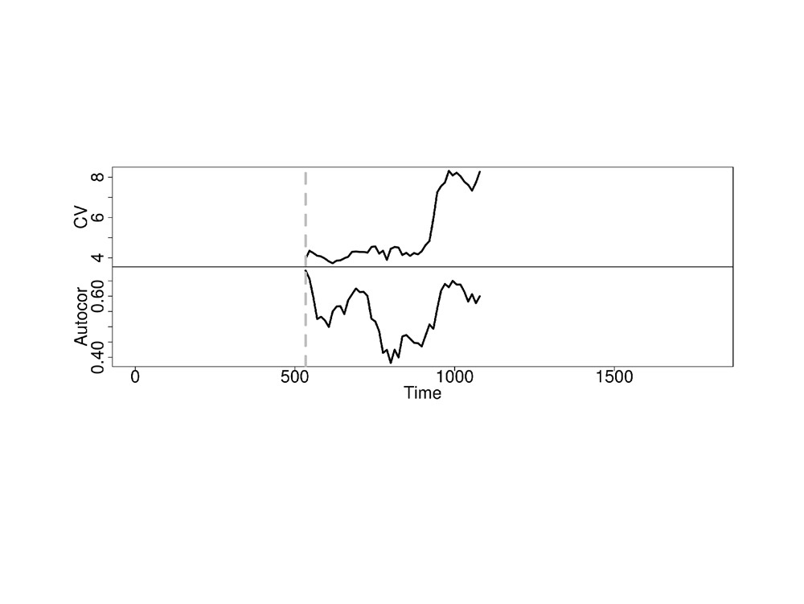
All we have is a squiggle
Carl Boettiger & Alan Hastings, UC Davis cboettig@ucdavis.edu
Early Warning Signs
23/77

Slide 64
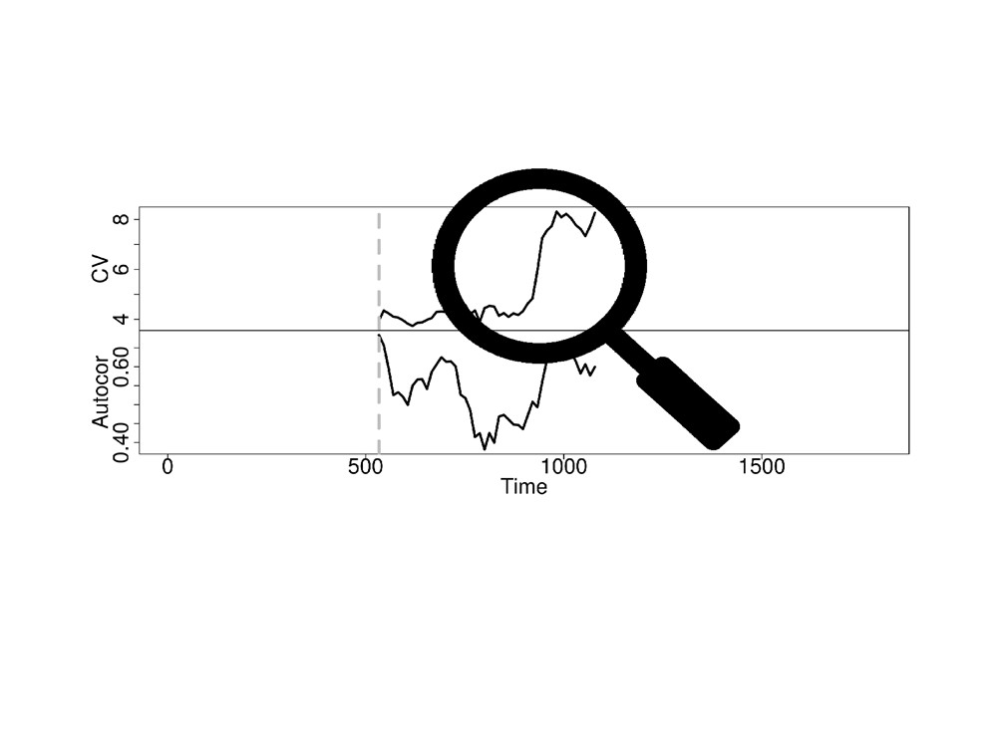
All we have is a squiggle
Making predictions from squiggles is hard
Carl Boettiger & Alan Hastings, UC Davis cboettig@ucdavis.edu
Early Warning Signs
24/77

Slide 65
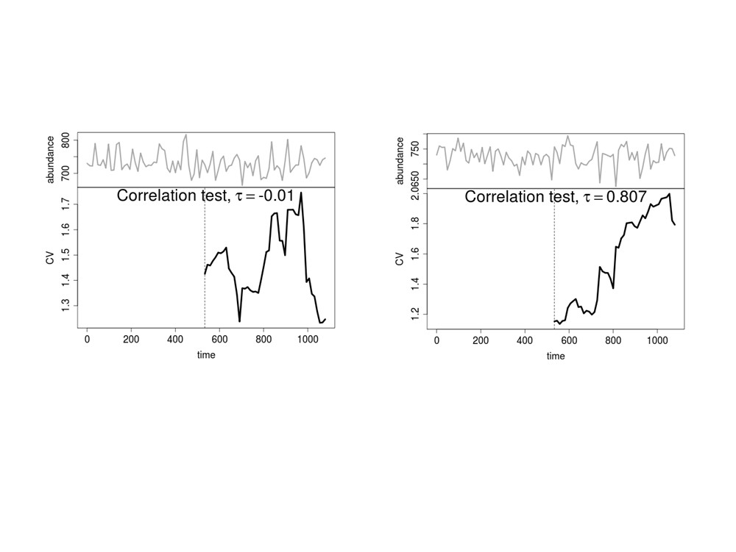
What’s an increase in a summary statistic (Kendall’s tau)?
Carl Boettiger & Alan Hastings, UC Davis cboettig@ucdavis.edu
Early Warning Signs
32/77

Slide 66
What’s an increase?
τ ∈[−1,1]quantifies the trend.
Carl Boettiger & Alan Hastings, UC Davis cboettig@ucdavis.edu
Early Warning Signs
32/77

Slide 67

Unfortunately. . .
Both patterns come from a stable process!
Carl Boettiger & Alan Hastings, UC Davis cboettig@ucdavis.edu
Early Warning Signs
33/77

Slide 68
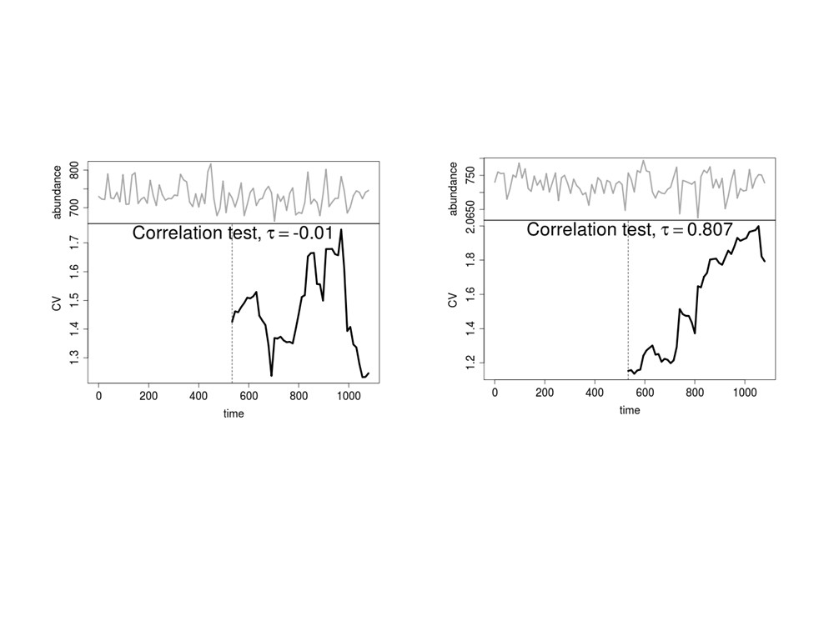
Typical?
False alarm!
Carl Boettiger & Alan Hastings, UC Davis cboettig@ucdavis.edu
Early Warning Signs
34/77

Slide 69
Typical?
False alarm!
How often do we see false alarms?
Carl Boettiger & Alan Hastings, UC Davis cboettig@ucdavis.edu
Early Warning Signs
34/77

Slide 70
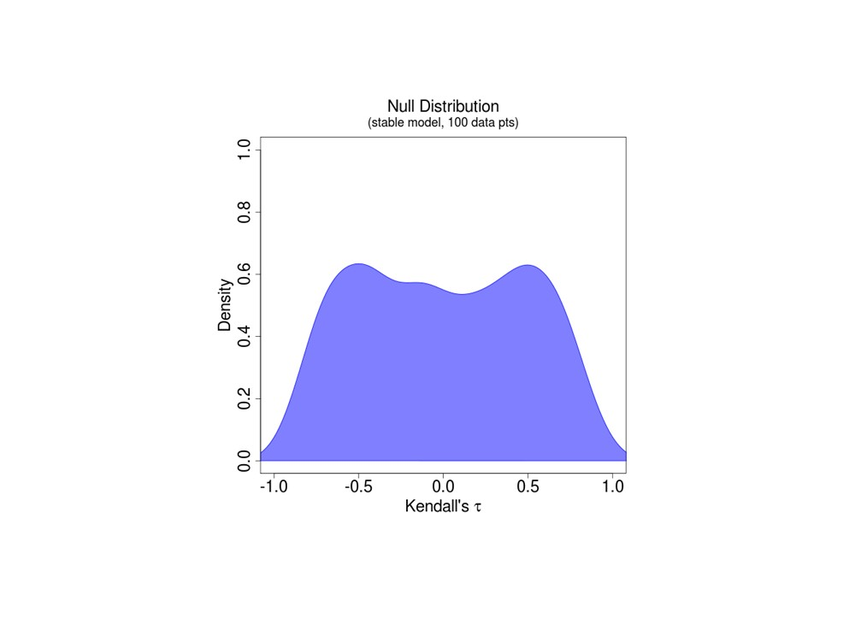
Often. τ can take any value in a stable system
(We introduce a method to estimate this distribution on given
data, ∼ Dakos et al. 2008)
Carl Boettiger & Alan Hastings, UC Davis cboettig@ucdavis.edu
Early Warning Signs
35/77

Slide 71
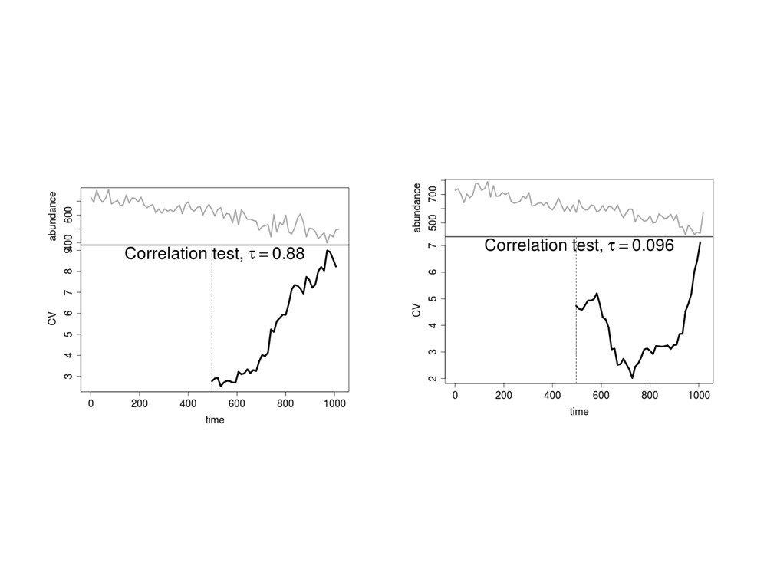
Another way to be wrong
Warning Signal?
Failed Detection?
Carl Boettiger & Alan Hastings, UC Davis cboettig@ucdavis.edu
Early Warning Signs
36/77

Slide 72
Another way to be wrong
Warning Signal?
Failed Detection?
Carl Boettiger & Alan Hastings, UC Davis cboettig@ucdavis.edu
Early Warning Signs
36/77

Slide 73
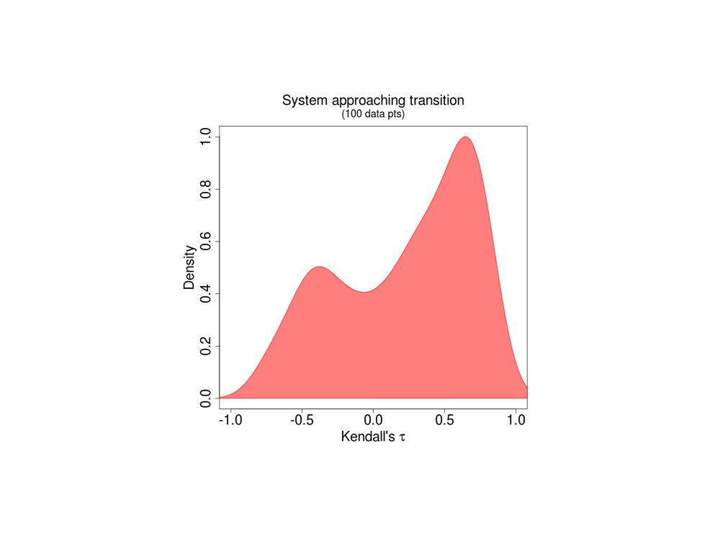
τ can take any value in a collapsing system
(Using a novel, general stochastic model to estimate)
Carl Boettiger & Alan Hastings, UC Davis cboettig@ucdavis.edu
Early Warning Signs
37/77

Slide 74
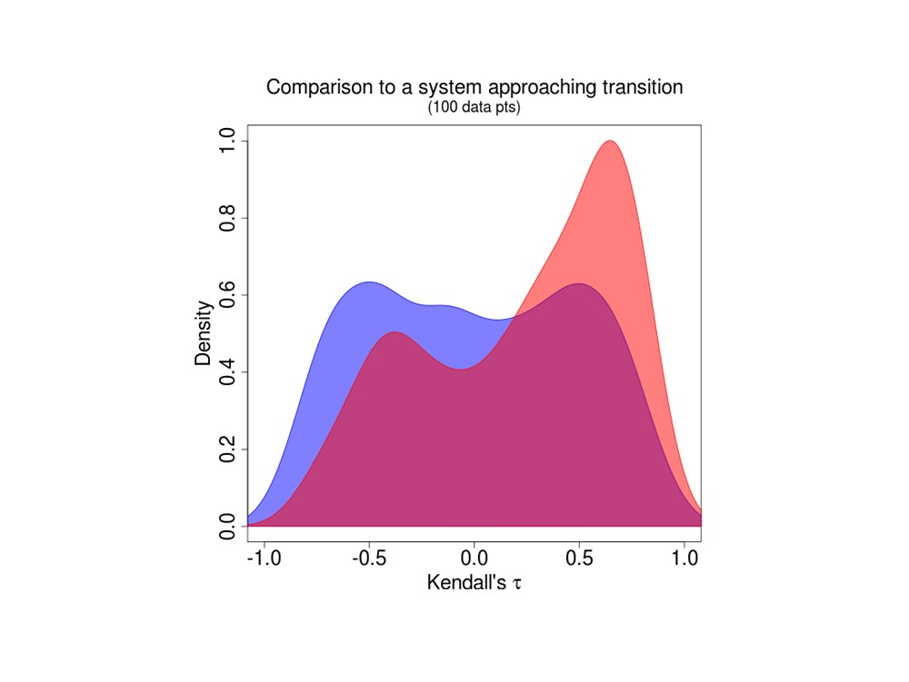
Carl Boettiger & Alan Hastings, UC Davis cboettig@ucdavis.edu
Early Warning Signs
38/77

Slide 75
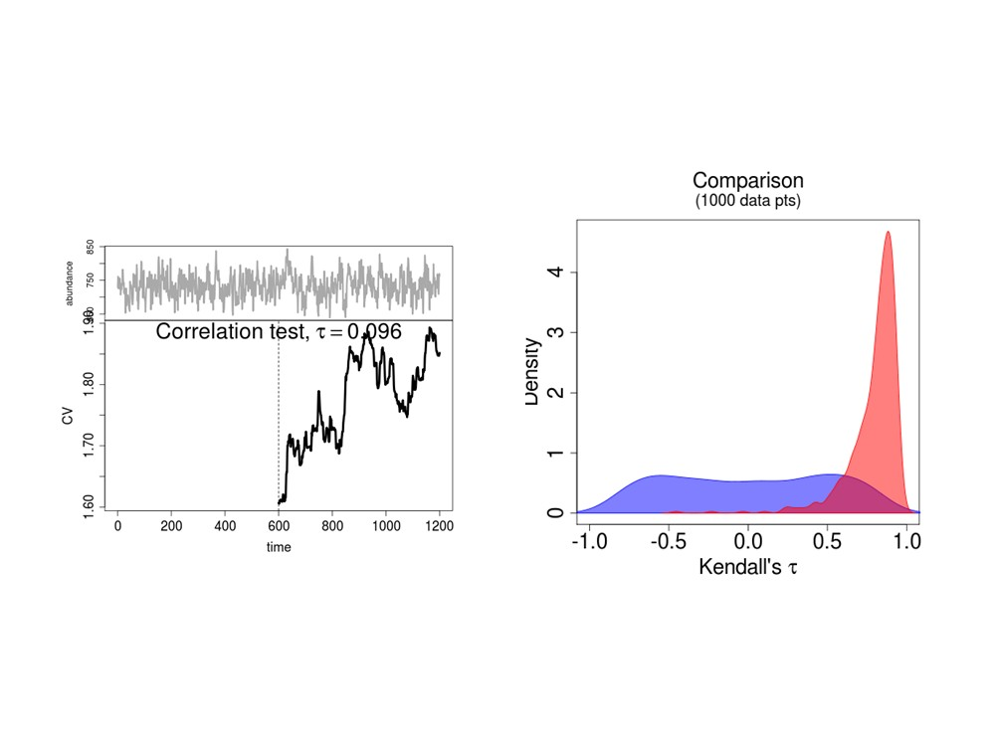
How much data is necessary?
Carl Boettiger & Alan Hastings, UC Davis cboettig@ucdavis.edu
Early Warning Signs
39/77

Slide 76
Beyond the Squiggles
general models by likelihood: stable and critical
Carl Boettiger & Alan Hastings, UC Davis cboettig@ucdavis.edu
Early Warning Signs
40/77

Slide 77
Beyond the Squiggles
general models by likelihood: stable and critical
simulated replicates for null and test cases
Carl Boettiger & Alan Hastings, UC Davis cboettig@ucdavis.edu
Early Warning Signs
40/77

Slide 78
Beyond the Squiggles
general models by likelihood: stable and critical
simulated replicates for null and test cases
Use model likelihood as an indicator (Cox 1962)
Carl Boettiger & Alan Hastings, UC Davis cboettig@ucdavis.edu
Early Warning Signs
40/77

Slide 79
Beyond the Squiggles
general models by likelihood: stable and critical
simulated replicates for null and test cases
Use model likelihood as an indicator (Cox 1962)
Carl Boettiger & Alan Hastings, UC Davis cboettig@ucdavis.edu
Early Warning Signs
40/77

Slide 80



Slide 81

Do we have enough data to tell?
Carl Boettiger & Alan Hastings, UC Davis cboettig@ucdavis.edu
Early Warning Signs
44/77

Slide 82
How about Type I/II error?
Carl Boettiger & Alan Hastings, UC Davis cboettig@ucdavis.edu
Early Warning Signs
45/77

Slide 83
Formally, identical.
Carl Boettiger & Alan Hastings, UC Davis cboettig@ucdavis.edu
Early Warning Signs
46/77

Slide 84
Linguistically, a disaster.
Carl Boettiger & Alan Hastings, UC Davis cboettig@ucdavis.edu
Early Warning Signs
47/77

Slide 85
Instead: focus on trade-off
Carl Boettiger & Alan Hastings, UC Davis cboettig@ucdavis.edu
Early Warning Signs
48/77

Slide 86
Receiver-operator characteristics (ROCs):
Visualize the trade-off between
false alarms and failed detection
Carl Boettiger & Alan Hastings, UC Davis cboettig@ucdavis.edu
Early Warning Signs
49/77

Slide 87
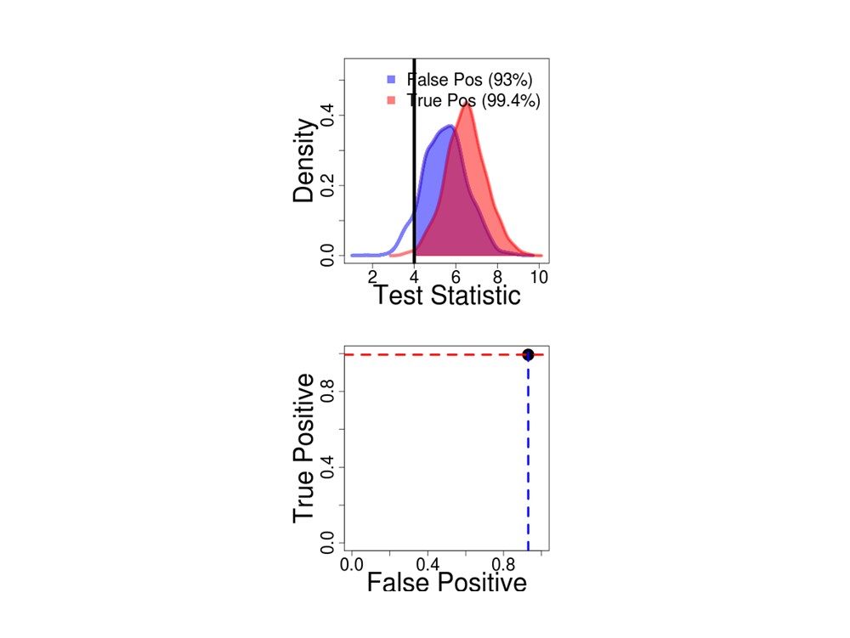
Carl Boettiger & Alan Hastings, UC Davis cboettig@ucdavis.edu
Early Warning Signs
50/77

Slide 88
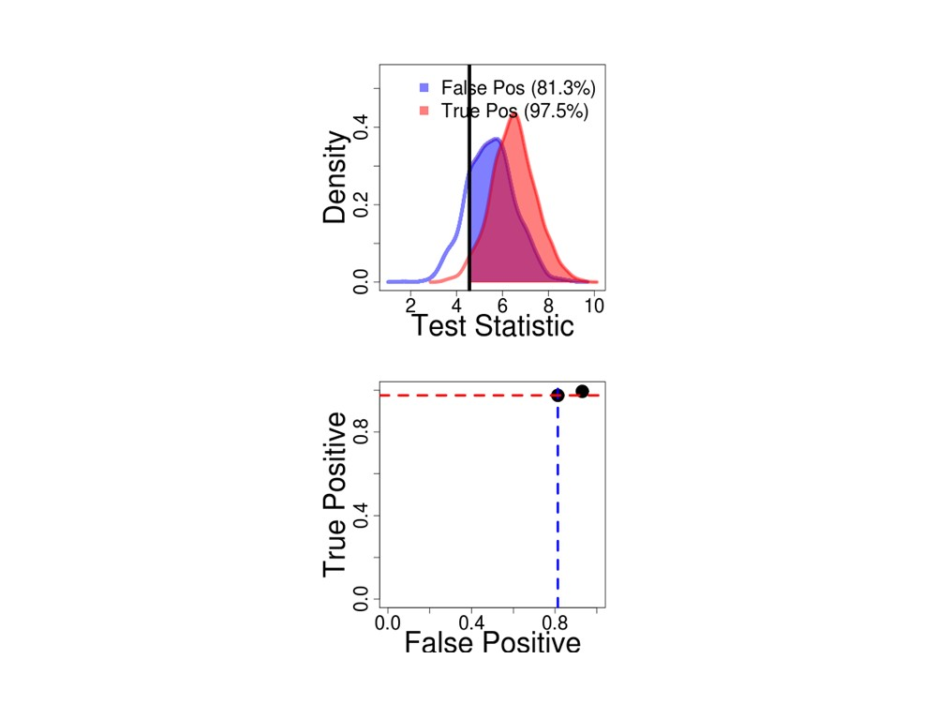
Carl Boettiger & Alan Hastings, UC Davis cboettig@ucdavis.edu
Early Warning Signs
51/77

Slide 89
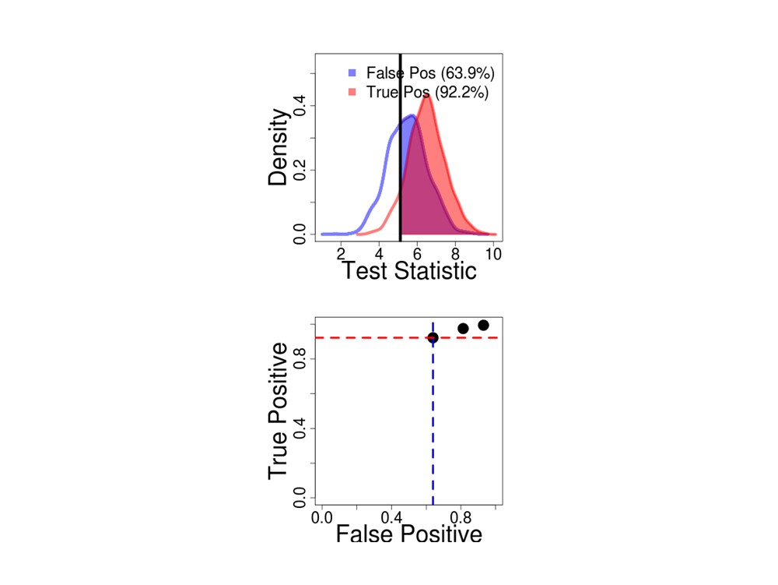
Carl Boettiger & Alan Hastings, UC Davis cboettig@ucdavis.edu
Early Warning Signs
52/77

Slide 90
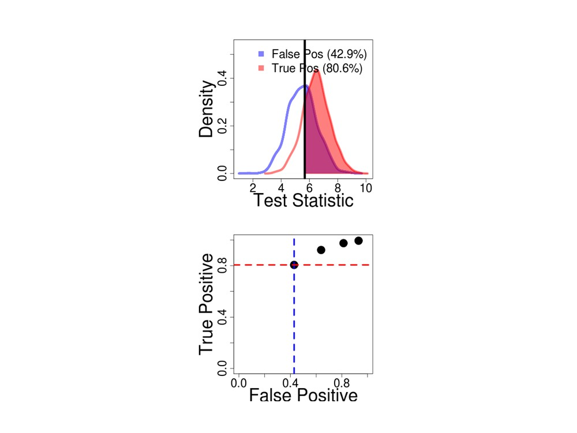
Carl Boettiger & Alan Hastings, UC Davis cboettig@ucdavis.edu
Early Warning Signs
53/77

Slide 91

Carl Boettiger & Alan Hastings, UC Davis cboettig@ucdavis.edu
Early Warning Signs
54/77

Slide 92

Carl Boettiger & Alan Hastings, UC Davis cboettig@ucdavis.edu
Early Warning Signs
55/77

Slide 93

Carl Boettiger & Alan Hastings, UC Davis cboettig@ucdavis.edu
Early Warning Signs
56/77

Slide 94

Carl Boettiger & Alan Hastings, UC Davis cboettig@ucdavis.edu
Early Warning Signs
57/77

Slide 95

Carl Boettiger & Alan Hastings, UC Davis cboettig@ucdavis.edu
Early Warning Signs
58/77

Slide 96

Carl Boettiger & Alan Hastings, UC Davis cboettig@ucdavis.edu
Early Warning Signs
59/77

Slide 97

Carl Boettiger & Alan Hastings, UC Davis cboettig@ucdavis.edu
Early Warning Signs
60/77

Slide 98

Carl Boettiger & Alan Hastings, UC Davis cboettig@ucdavis.edu
Early Warning Signs
61/77

Slide 99

Carl Boettiger & Alan Hastings, UC Davis cboettig@ucdavis.edu
Early Warning Signs
62/77

Slide 100

Carl Boettiger & Alan Hastings, UC Davis cboettig@ucdavis.edu
Early Warning Signs
63/77

Slide 101

Carl Boettiger & Alan Hastings, UC Davis cboettig@ucdavis.edu
Early Warning Signs
64/77

Slide 102

Carl Boettiger & Alan Hastings, UC Davis cboettig@ucdavis.edu
Early Warning Signs
65/77

Slide 103

Carl Boettiger & Alan Hastings, UC Davis cboettig@ucdavis.edu
Early Warning Signs
66/77

Slide 104

Carl Boettiger & Alan Hastings, UC Davis cboettig@ucdavis.edu
Early Warning Signs
67/77

Slide 105

Carl Boettiger & Alan Hastings, UC Davis cboettig@ucdavis.edu
Early Warning Signs
68/77

Slide 106

Carl Boettiger & Alan Hastings, UC Davis cboettig@ucdavis.edu
Early Warning Signs
69/77

Slide 107

Carl Boettiger & Alan Hastings, UC Davis cboettig@ucdavis.edu
Early Warning Signs
70/77

Slide 108

Carl Boettiger & Alan Hastings, UC Davis cboettig@ucdavis.edu
Early Warning Signs
71/77

Slide 109

(a) Stable
(b) Deteriorating
(c) Daphnia
(d) Glaciation III
τ=-0.7
τ=0.72
τ=0.93
(p = 1e-05)
τ=0.22
(p = 0.18)
(p = 0.0059)
(p = <2e-16)
τ=0.7
τ=-0.15
(p = 0.35)
τ=0
(p = 1.6e-06)
(p = 1)
τ=0.64
(p = 3.6e-13)
τ=0.72
τ=-0.15
(p = 0.35)
τ=0.61
τ=-0.54
(p = 5.6e-06)
(p = 0.025)
(p = 9.2e-10)
τ=-0.67
τ=0.31
τ=0.72
τ=0.11
(p = 0.21)
(p = 2.3e-05)
(p = 0.049)
(p = 0.0059)
0 400 800
0 400 800
Time
160 200 240
0 10000 25000
Carl Boettiger & Alan Hastings, UC Davis cboettig@ucdavis.edu
Early Warning Signs
72/77

Slide 110

Carl Boettiger & Alan Hastings, UC Davis cboettig@ucdavis.edu
Early Warning Signs
73/77

Slide 111

(a) Simulation
(b) Daphnia
(c) Glaciation III
Likelihood, 0.85
Likelihood, 0.87
Likelihood, 1
Variance, 0.8
Variance, 0.59
Variance, 0.46
Autocorr, 0.51
Autocorr, 0.56
Autocorr, 0.4
Skew, 0.5
Skew, 0.56
Skew, 0.48
CV, 0.81
CV, 0.65
CV, 0.49
0.0
0.2
0.4
0.6
0.8
1.0
0.0
0.2
0.4
0.6
0.8
1.0
0.0
0.2
0.4
0.6
0.8
1.0
False Positive
False Positive
False Positive
Carl Boettiger & Alan Hastings, UC Davis cboettig@ucdavis.edu
Early Warning Signs

Slide 112

Carl Boettiger & Alan Hastings, UC Davis cboettig@ucdavis.edu
Early Warning Signs

Slide 113

Summary of regime shift detection
Estimate false alarms & failed detections
Identify which indicators are best
Explore the influence of more data on these rates.
Carl Boettiger & Alan Hastings, UC Davis cboettig@ucdavis.edu
Early Warning Signs

Slide 114
Conclusions
We need realistic statistical approaches
  Design approaches with goals in mind
    Management
    Adaptation
  Recognize limits to statistics
  Incorporate appropriate time scales
  Ideally use a model based approach
We need to explore all possible mathematical causes for regime shifts

